Slide 1


Web-Based Management Systems
& Development
A comprehensive overview of full-stack web application architecture, system design principles, and modern engineering practices.

Slide 2

Architecture & Fundamentals
Understanding how data, servers, and interfaces connect in enterprise systems.

Slide 3


Web Management Systems
What is a Web Management System?
Core Enterprise Advantages
A web-based management system is a software platform accessed via browsers that centralizes data handling, automates business workflows, and provides real-time administrative oversight.
Universal Access: Zero client installation needed; operates seamlessly across platforms and operating systems.
Centralized Logic: Updates, security patches, and database migrations are deployed once on servers and available instantly.
Unlike traditional static websites, management platforms rely heavily on state management, authentication, role-based access control, and dynamic data processing.
Scalability: Cloud-native hosting enables dynamic resource scaling based on concurrency demand.

Slide 4
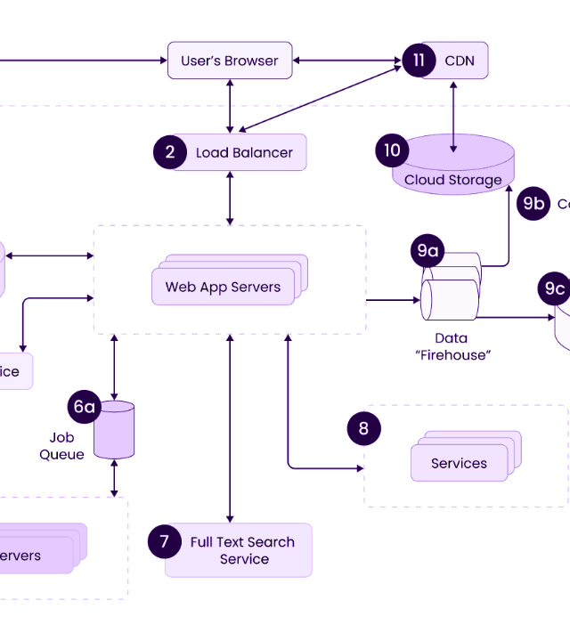
3-Tier System Architecture
Structured Separation of Concerns
Presentation Tier: Interactive client interface built with modern HTML5, CSS3, and JS framework runtimes.
Application Tier: Server backend handling authorization, API routing, transaction management, and core business rules.
Data Tier: Relational and NoSQL persistence layers maintaining structural integrity and high-throughput query caching.

Slide 5






Core Tech Stack Components
Frontend Layer
Backend Runtime
Database System
Delivers reactive user interfaces using frameworks like React or Next.js. Focuses on component reusability, state synchronization, and DOM efficiency.
Powers business logic via Node.js, Python, or Java. Exposes RESTful or GraphQL endpoints and manages server-side security checks.
Stores transactional records in PostgreSQL or MySQL, while utilizing Redis or MongoDB for fast caching and unstructured document storage.

Slide 6
Lifecycle & Standards
Best practices for building maintainable, scalable, and secure software.

Slide 7




Development Lifecycle Roadmap
2. System Design
4. CI/CD Launch
Create database schemas, wireframes, and API contract specifications.
Automated security scans, integration testing, and cloud deployment.
1. Analysis
3. Execution
Gather business rules, map user roles, and outline technical scope.
Agile sprint development, component coding, and unit testing.

Slide 8
Core Web Vitals Performance
<200ms
Performance as a Core Requirement
Modern management systems require instant responsiveness. High latency directly hinders operational efficiency and causes user fatigue during daily tasks.
Interaction to Next Paint (INP)
LCP Target (<2.5s): Main dashboard elements must load rapidly.
CLS Target (<0.1): Visual layout stability prevents accidental clicks during data entry.

Slide 9
Rendering Architecture Models
Architecture | Primary Advantage | Best Use Case | Key Consideration
Client-Side (CSR) | Rich interactivity after initial bundle load | Internal Admin Dashboards | Higher initial load time
Server-Side (SSR) | Fast initial page paint & dynamic data rendering | Content & Data Portals | Increased server infrastructure CPU load
Static Site (SSG) | Maximum performance & cheap edge hosting | Documentation & Knowledge Bases | Requires rebuilds for dynamic data updates
Edge / Hybrid | Sub-50ms global response latency | Global Enterprise Systems | Complex deployment pipelines

Slide 10
Security & Access Control
Role-Based Access Control (RBAC): Enforce fine-grained user permissions at both frontend UI route guards and backend API authorization middleware.
OWASP Top 10 Defense: Implement parameterized SQL queries to prevent injection attacks and enforce Content Security Policies (CSP) against XSS.
Modern Authentication: Use OAuth 2.0 / OIDC and WebAuthn for secure, multi-factor, and phishing-resistant user logins.
DevSecOps Integration: Scan dependencies automatically for vulnerability CVEs during automated pull request builds.

Slide 11
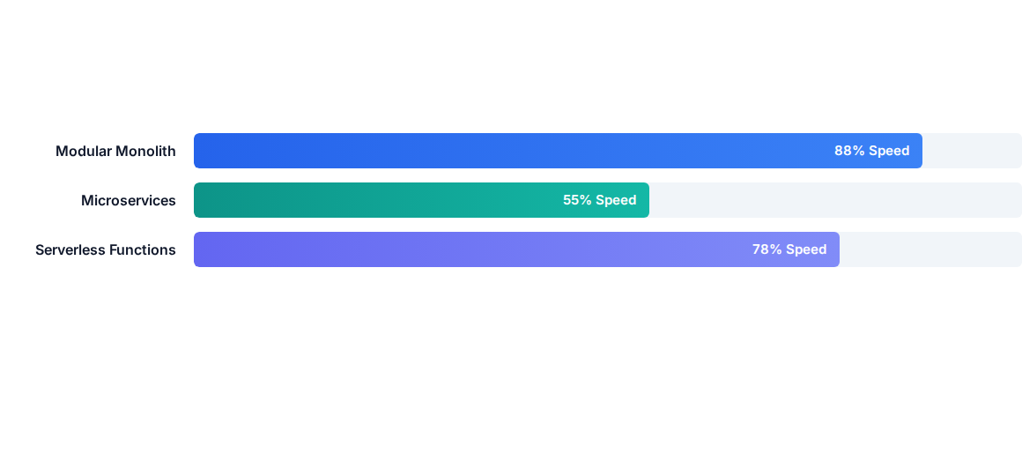
Architecture Tradeoffs
Comparison of early development velocity across architectures. For early-stage and medium systems, modular monoliths offer maximum velocity with minimal operational overhead.

Slide 12

Questions & Answers
Thank you! Let's discuss system design, implementation strategies, or tech stack options.

Slide 13

Image Sources
https://ebiz-images.b-cdn.net/wp-media-folder-esparkbiz/wp-content/uploads/2022/12/10-1-1.png
Source: www.esparkinfo.com

